Slide 1
Lakeridge Montessori Program
Information Night
March 22, 2022

Slide 2
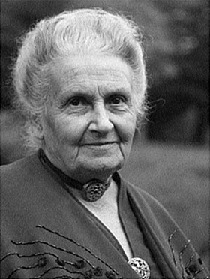
One test of the correctness of educational procedure is the happiness of the child.
-Maria Montessori

Slide 3
Montessori – Casa Program
Montessori Kindergarten: Essential & Empowering - Bing video

Slide 4
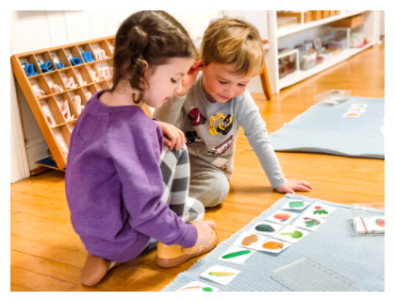
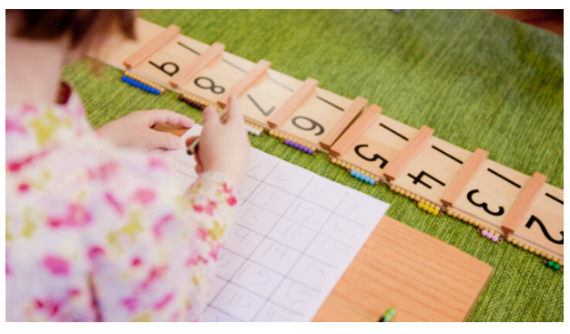
The scientifically designed Montessori materials help your child learn through hands-on use and exploration. Through continued use, your child develops a concrete understanding of abstract concepts, providing a solid foundation for learning into the future.

Slide 5
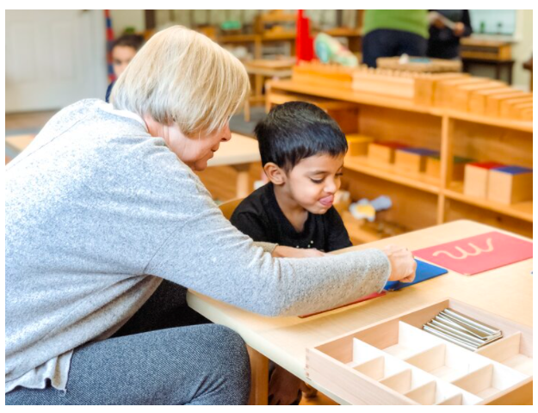
Teachers:
trained to respect your child’s unique potential and connect the student with the lesson best suited at the precise moment of development
challenge children according to their ability, not to a generic standard
encourage student to explore and use materials at their own developmental level and pace
thoughtfully prepare the classroom environment to invite curiosity and stimulate learning
find opportunities to refer children to one another; support students’ spontaneous cooperative efforts
are available to students as they select the tasks they need to work on, and strive to attain competency in a number of specific tasks laid out in the prepared Montessori classroom

Slide 6
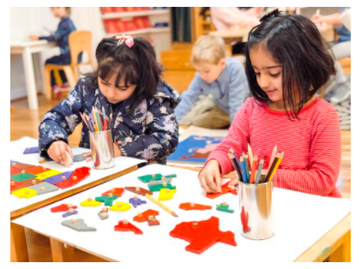
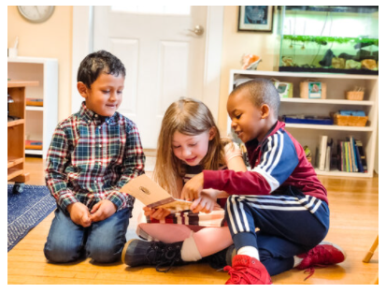
Kindergarten students use a variety of carefully selected materials to help them explore concepts and achieve abstraction.
Each aspect of the curriculum utilizes manipulatives that help students progress. These materials are selected so that they follow a natural progression that aligns with benchmarks for childhood development and serve not to distract from learning, but as an aid to understanding larger concepts.

Slide 7
Lakeridge Casa
OPEN TO CHILDREN THAT WILL BE 5 YEARS OLD BY January 31, 2023
Kindergarten program
Morning class

Slide 8
The Montessori Lower Elementary Classroom
Key Aspects of the Prepared Environment
- Ms. Rebecca Jenkins – classroom Teacher

Slide 9
The Prepared Environment
The Lower Elementary classroom, like all other Montessori classrooms, is prepared based on sensitive periods and known developmental needs of children in this age range (6-9). It provides children freedom within limits and allows for a balance between choice and responsibility, resulting in the spontaneous activity of the child.

Slide 10
Aspects of the Prepared Environment
Multi-aged Groupings
Self-Directed Learning
Spontaneous Activity
Hands-on, Discovery-Based Learning
Concentration and Meaningful Collaborative Work
Freedom within Limits
Teacher as Guide
Uninterrupted Work Cycle

Slide 11
Multi-aged Groupings, Self-Directed Learning & Spontaneous Activity
Never help a child with a task at which he feels he can succeed.
-Maria Montessori

Slide 12
Multi-Aged Groupings allow for real world dynamics in which the child is both a learner and leader.
Self-Directed Learning
The Montessori Elementary classroom may be somewhat of a leap of faith for parents. The busy, seemingly chaotic buzz that occurs in the Montessori Lower Elementary Class may appear unstructured. With math happening in one area, reading in another and presentations in another, one may not understand the purposeful work occurring, yet it is the basis for the self-directed learning of the Montessori method.

Slide 13
Hands-on, Discovery Based Learning
The hand is the instrument of the mind.
- Maria Montessori

Slide 14
Hands-On, Discovery-Based Learning
Presentations are the catalyst through which children are then able to learn from their own experiences.

Slide 15
Concentration and Meaningful Collaborative Work
The child whose attention has once been held by a chosen object, while he concentrates his whole self on the repetition of the exercise, is a delivered soul in the sense of spiritual safety of which we speak. From this moment there is no need to worry about him - except to prepare an environment which satisfies his needs, and to remove obstacles which may bar his way to perfection.
- Maria Montessori.

Slide 16
Concentration and Meaningful Collaborative Work
Through engagement with the environment the child creates within, a power of concentration. This skill is then transferred to group work and collaboration as the need for social interaction grows.

Slide 17
Freedom within Limits
To let the child do as he likes when he has not yet developed any power of control is to betray the idea of freedom.
-Maria Montessori

Slide 18
Freedom within Limits
This becomes an important element in the Elementary classroom as the child’s reasoning mind develops in the second plane. As such, freedom to choose is a significant aspect in the formation of responsibility. Main freedoms to look for in the Elementary classroom—freedom to choose work, freedom to work in groups, and freedom to talk and move about.

Slide 19
Teacher as Guide & Uninterrupted Work Cycle
To assist a child, we must provide him with an environment which will enable him to develop freely. ― Maria Montessori

Slide 20
Teacher as Guide & Uninterrupted Work Cycle
Teacher as Guide
In the Montessori Classroom the teacher is a guide; a co-creator of culture, community and learning. Classroom teachers ensure that Saskatchewan curricular outcomes are presented within each year of the 3 year cycle (and within the Kindergarten Casa program).
Uninterrupted Work Cycle
The importance of the Uninterrupted Work Cycle carries through to all Montessori classrooms. This time is essential for optimum learning to occur.

Slide 21
Assessment within montessori
Keeping track of children’s progress and growth over time are critical tasks for Montessori teachers and deeply intertwined with the work of guiding children through the breadth of the Montessori curriculum.
In Montessori, continual assessment is organically built into the essential functioning of an authentic classroom. The daily use of observation combined with the ability of the learning materials to reveal a child’s understanding along with rigorous record keeping enable Montessori teachers to closely follow their students’ development.
In the elementary class there are additional tools, such as daily recording of activities by the child and regular one-on-one conferences with the child that contribute to the teacher’s effort to assess every child’s progress.

Slide 22
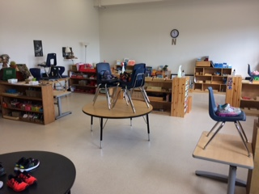
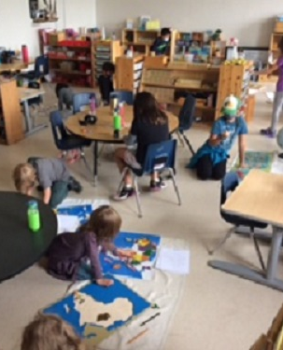

Slide 23
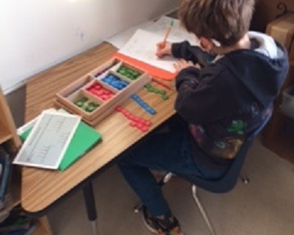
Using the stamp game to solve long division equations.

Slide 24
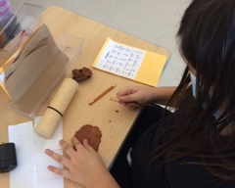
Exploring cuneiform writing as a follow up to The Fourth Great Lesson- The History of Writing.

Slide 25
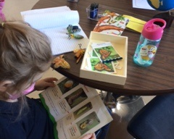
Zoology Study- Life Cycles of the Butterfly.

Slide 26
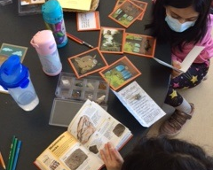
Functional Geography Study- Rocks & Minerals.

Slide 27
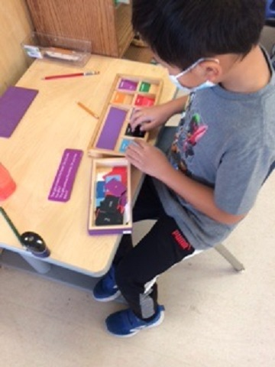
Using the grammar boxes to create grammatically correct sentences.

Slide 28
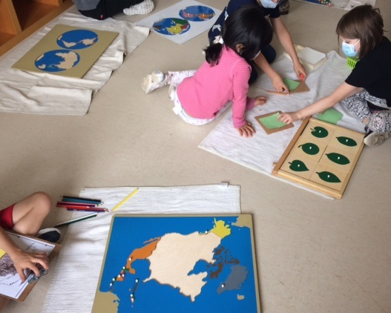
Mentoring- giving presentations on Types of Leaves work.

Slide 29
City Park School – Saskatoon Public Schools – Montessori Program
- Parent Testimonials

Slide 30
ADDITIONAL INFORMATION…..

Slide 31
APPLICATIONS PROCESS
Applications are still be accepted.
We will try to accommodate families, whenever possible.
Families are welcome to apply to Lakeridge Montessori as well as City Park Montessori.
* please note Casa is only available at Lakeridge

Slide 32
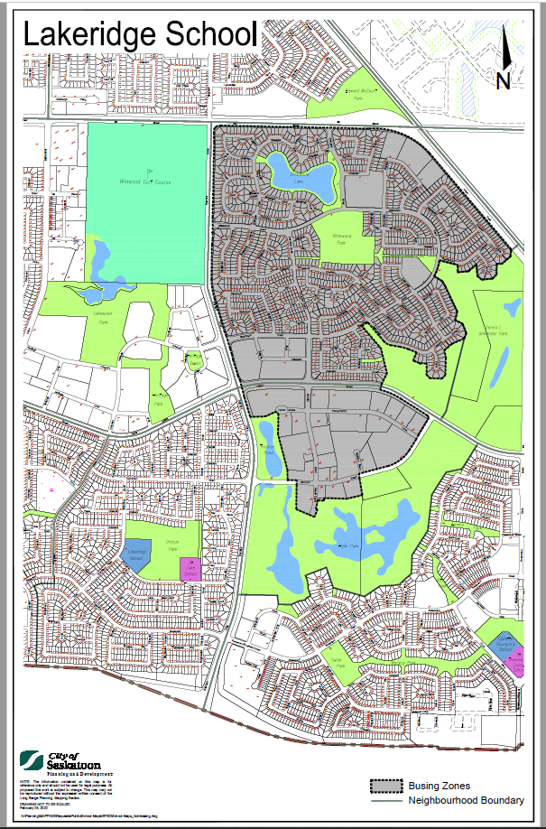
TRANSPORTATION
Transportation is available to students that live within the Lakeridge School Bussing Zone.
Casa students within the bussing area are able to ride the bus to school. However, families must make alternate arrangements to get them home at the end of the morning.

Slide 33
Classroom Community School Supplies
In the Montessori Classroom, student supplies are communal: pencils, crayons, etc.
We will be asking for $110 per student.
We will then provide students with the consumable supplies they will need throughout the year (all school supplies).
All students need to supply is a backpack and indoor running shoes.

Slide 34
Questions….

Slide 35
Kidstime/kindercare
- Kelsey Ekren

